Slide 1
Introduction to Software Requirements
1

Slide 2
Contents
What is a requirement?
Types and levels of requirements
Requirements engineering
Requirements development
Requirements management
Misclaneous requirements related concepts

Slide 3
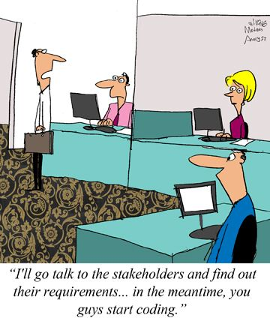
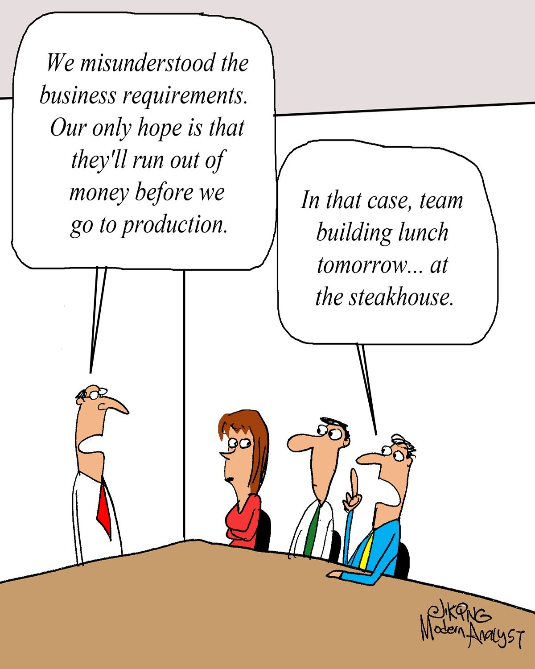
…
“I’ll go talk to the stakeholders and find out their requirements … in the mean time, you guys start coding.”

Slide 4
Common Reasons for Project Faliure
In the 10th Global Project Management Survey by PMI, 4000+ Project Management Practitioners globally were asked the following question:
Of the projects started in your organization in the past 12 months that were deemed failures, what were the primary causes of those failures? (Select up to 3)

Slide 5
Common Reasons for Software Project Faliure
In 2020, Forbes Technology Council members shared common reasons why software projects fail in their experience. 6 of the14 responses are given below:
Not understanding the needs of the business
The business must clearly articulate the requirements in detail
Not starting with the end customer
Sometimes developers discover that the problem they solved wasn’t actually the problem their customer needed to be solved
Working in a silo (Isolation Mode)
Sometimes teams start to build something that does not address the right problem due to misalignment between the business and tech team
Inability to reach consensus on priorities
The sponsors and project teams are not clear on top priorities of project.
Unclear requirements
Common reasons software projects fail is unclear requirements and the lack of a detailed explanation; often clients themselves are not sure exactly what they want
Not enough emphasis on soft skills
Software projects run into challenges because they are super-focused on the technical work but not applying enough energy toward training, coaching, team building and soft skills

Slide 6
What is a requirement?
The term requirement is not used in the software industry in a consistent way.
There are varying terminologies and perspectives
user requirement, software requirement, business requirement, functional requirement, system requirement, product requirement, project requirement, user story, feature, constraint …
In some cases, a requirement is simply a high-level, abstract statement of a service that the system should provide or a constraint on the system.
A customer’s definition of requirements might sound like a high-level product concept to the developer.
At the other extreme, it is a detailed, formal definition of a system function.
The developer’s notion of requirements might sound like a detailed user interface design to the user.
This diversity of understanding leads to confusion.

Slide 7
How to Define Requirement ?
Brian Lawrence suggests that a requirement is “anything that drives design choices”
PMI describes a requirement as “a condition or capability that is necessary to be present in a product, service, or result to satisfy a business need”.
Ian Sommerville mentions that “the requirements for a system are the descriptions of the services provided by the system and its operational constraints”.

Slide 8
Requirements
International Standard ISO/IEC/IEEE 24765:2017(E) “Systems and Software Engineering – Vocabulary” gives following definitions of requirement:
Statement that translates or expresses a need and its associated constraints and conditions
ISO/IEC TS 24748-1:2016 Systems and software engineering – Life cycle management
ISO/IEC/IEEE 29148:2011 Systems and software engineering – Life cycle processes – Requirements engineering
Condition or capability that must be met or possessed by a system, system component, product, or service to satisfy an agreement, standard, specification, or other formally imposed documents
IEEE 730-2014 IEEE Standard for Software Quality Assurance Processes
Provision that contains criteria to be fulfilled
ISO/IEC 14143-2:2011 Information technology – Software measurement – Functional size measurement
A condition or capability that must be present in a product, service, or result to satisfy a contract or other formally imposed specification
A Guide to the Project Management Body of Knowledge (PMBOK® Guide) – 5th Ed.

Slide 9
Requirement (information) types
Term | Definition
Business Requirement | A high-level business objective of the organization that builds a product or of a customer who procures it.
Business Rule | A policy, guideline, standard, or regulation that defines or constrains some aspect of the business. Not a software requirement in itself, but the origin of several types of software requirements.
Constraint | A restriction that is imposed on the choices available to the developer for the design and construction of a product
External Interface Requirement | A description of a connection between a software system and a user, another software system, or a hardware device.
Feature | A high-level business objective of the organization that builds a product or of a customer who procures it.

Slide 10
Requirement (information) types
Term | Definition
Functional Requirement | A description of a behavior that a system will exhibit under specific conditions.
Nonfunctional Requirement | A description of a property or characteristic that a system must exhibit or a constraint that it must respect.
Quality Attribute | A kind of nonfunctional requirement that describes a service or performance characteristic of a product.
System Requirement | A top-level requirement for a product that contains multiple subsystems, which could be all software or software and hardware.
User Requirement | A goal or task that specific classes of users must be able to perform with a system, or a desired product attribute.

Slide 11
Requirement Levels
Business Requirements
User Requirements
Functional Requirements
Describe why the organization is implementing the system. The focus is on the business objectives of the organization or the customer who requests the system.
Describe goals or tasks the users must be able to perform with the product that will provide value to someone
What the developers must implement
to enable users to accomplish their tasks
thereby satisfying the business needs
Specify the behaviours the product will exhibit under specific conditions.

Slide 12
Requirement Levels
Relationships among several types of requirements information.
Solid arrows mean “are stored in”
Dotted arrows mean “are the origin of” or “influence.”
Data requirements are not shown explicitly

Slide 13
Working with 3 requirement levels
How various stakeholders (Customer , User, Business Analyst)might participate in eliciting the three levels of requirements.
Different organizations use a variety of names for the roles involved in these activities
think about who performs these activities in your organization
The role names often differ depending on whether the developing organization is an internal corporate entity or a company building software for commercial use
Corporate Roles (overall management) Commercial Roles (revenue generation)

Slide 14

What is Requirements Engineering ?
Anyone involved in the development of products, systems or software is faced with various questions:
What are the requirements – i.e. the capabilities and characteristics – of the desired product? How can these requirements be specified
– i.e. collected, analysed, documented and validated?
How should requirements be managed – i.e. released, possibly modified and tracked?
The answers to these questions are provided by Requirements Engineering
Requirements Engineering is the systematic procedure for specifying (developing) and managing requirements for a product, system or software.
But confusion about requirements terminology extends even
to what to call the whole discipline!

Slide 15
Requirements Engineering Elements
International Requirements Engineering Board (IREB) considers
Elicitation(Gathering Information)/determination of requirements
documentation as an adequate description of requirements
validation of requirements with the aim of ensuring quality
management of requirements
The International Institute of Business Analysis (IIBA) addresses
requirements elicitation of stakeholders (Customer , User, Business Analyst)
requirements management including communication
requirements analysis
IEEE 24765:2017(E) standard speaks of
discovering, eliciting and developing requirements
analysing requirements
determining verification methods and validating requirements
communicating, documenting and managing requirements

Slide 16
Requirements Engineering
We can split Requirements Engineering into two domains:
Requirements Development
Requirements Management

Slide 17
Requirements Development
Requirements development can be subdivided into:
Elicitation
Analysis
Specification
Validation
These sub-disciplines encompass all the activities involved with exploring, evaluating, documenting, and confirming the requirements for a product.

Slide 18
Elicitation
Elicitation encompasses all of the activities involved with discovering requirements, such as interviews, workshops, document analysis, prototyping, and others.
The key actions are:
Identifying the product’s expected user classes and other stakeholders.
Understanding user tasks and goals and the business objectives with which those tasks align.
Learning about the environment in which the new product will be used.
Working with individuals who represent each user class to understand their functionality needs and their quality expectations.

Slide 19
Elicitation Approaches
Requirements elicitation typically takes either a usage-centric or a product-centric approach
other strategies also are possible
The usage-centric strategy emphasizes understanding and exploring user goals to derive the necessary system functionality.
The product-centric approach focuses on defining features that you expect will lead to marketplace or business success.
Recommended to understand business objectives and user goals first, then use that insight to determine the appropriate product features and characteristics.

Slide 20
Analysis
Analysing requirements involves reaching a richer and more precise understanding of each requirement and representing sets of requirements in multiple ways.
The key actions are:
Analyzing the information received from users to distinguish their task goals from functional requirements, quality expectations, business rules, suggested solutions, and other information
Decomposing high-level requirements into an appropriate level of detail Deriving functional requirements from other requirements information Understanding the relative importance of quality attributes Allocating requirements to software components defined in the system architecture Negotiating implementation priorities
Identifying gaps in requirements or unnecessary requirements as they relate to the defined scope.

Slide 21
Specification
Requirements specification involves representing and storing the collected requirements knowledge in a persistent and well-organized fashion.
The principal activity is:
Translating the collected user needs into written requirements and diagrams suitable for comprehension, review, and use by their intended audiences.

Slide 22
Validation
Requirements validation confirms that you have the correct set of requirements information that will enable developers to build a solution that satisfies the business objectives.
The key actions are:
Reviewing the documented requirements to correct any problems before the development group accepts them.
Developing acceptance tests and criteria to confirm that a product based on the requirements would meet customer needs and achieve the business objectives.

Slide 23
Requirements Development
Iteration is a key to requirements development success
Plan for multiple cycles of exploring requirements, progressively refining requirements and confirming correctness with users.
This takes time and it can be frustrating but it’s an intrinsic aspect of dealing with the fuzzy uncertainty of defining a new software system.
You’re never going to get perfect requirements
Practically, the goal of requirements development is to accumulate a shared understanding of requirements that is good enough to allow construction of the entire product or next portion of the product at an acceptable level of risk.
The major risk is that of having to do excessive unplanned rework because the team didn’t sufficiently understand the requirements for the next chunk of work before starting design and construction.

Slide 24
Requirements Management
Requirements Management is an iterative set of activities that help ensure that elicitation, documentation, refinement, and changes of requirements is adequately dealt with during a lifecycle, with a view toward satisfying the overall mission or need in a quality manner and to the customers’ satisfaction.
The object is not to stifle change or to make it difficult, but the objective is to anticipate and accommodate the changes that you can always expect so as to minimize their disruptive impact on the project.

Slide 25
Requirements management activities
Defining the requirements baseline, often for a specific product release or development iteration
A requirements baseline is a snapshot in time that represents an agreed-upon, reviewed, and approved set of requirements that have been committed to a specific product release.
Baselining is a mechanism to package a set of requirements at a particular point in time and pass that off to the next group in the project team.
Evaluating the impact of proposed requirements changes and incorporating approved changes into the project in a controlled way
Keeping project plans current with the requirements as they evolve
Negotiating new commitments based on the estimated impact of requirements changes
Defining the relationships and dependencies that exist between requirements
Tracing individual requirements to their corresponding designs, source code, and tests
Tracking requirements status and change activity throughout the project

Slide 26
Requirements development and management

Slide 27
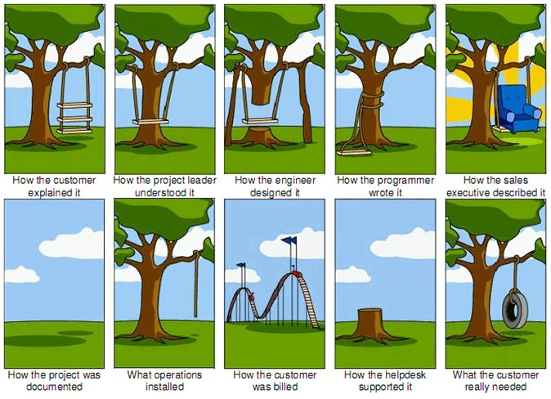

Slide 28
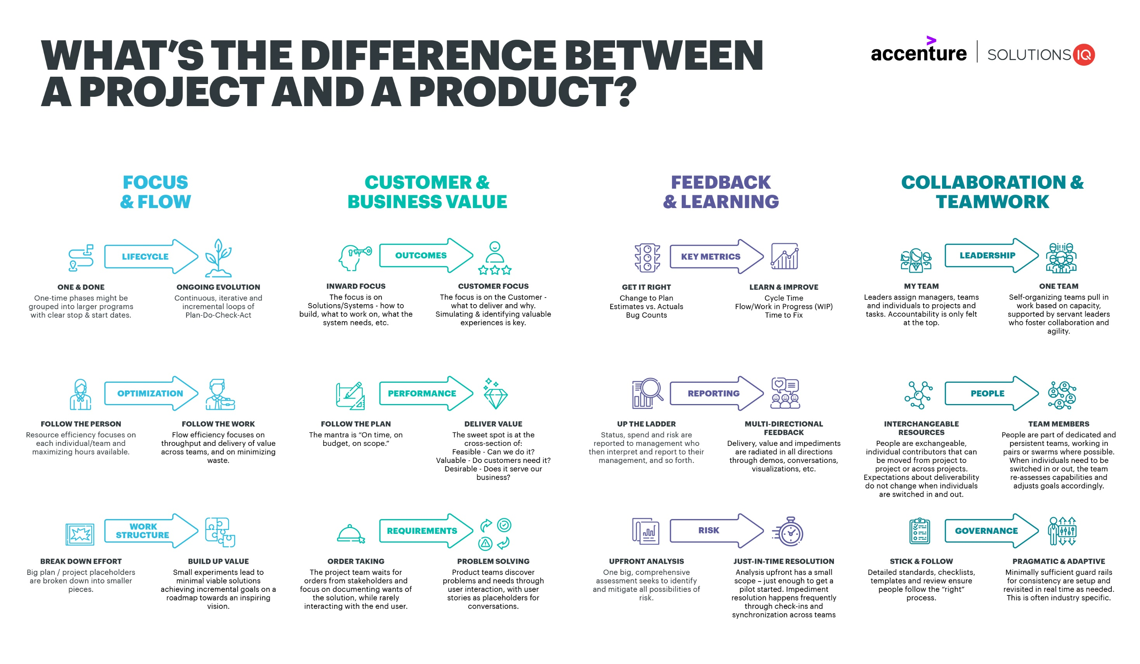

Slide 29
Product vs project requirements
Product requirements describe properties of a software system to be built; it outlines the product's purpose, its features, functionalities, and behaviour.
An SRS houses the product requirements, but it should not include design or implementation details, project plans, test plans, or similar information.
Project requirements are conditions or tasks that must be completed to ensure the success or completion of the project; it provides a clear picture of the work that needs to be done.
Project requirements are stored in Project Management Plan, which may include physical resource needs, staff training needs, marketing, and distribution requirements, etc.
This course does not directly address project requirements
That doesn’t mean that they aren’t important!
Project requirements often come up while eliciting product requirements
Identifying project requirements is a shared responsibility of the BA and the project manager

Slide 30
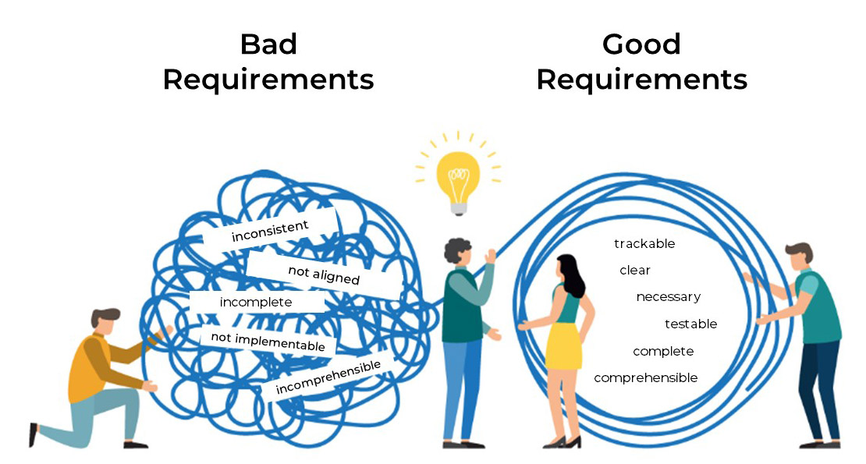

Slide 31
Requirements related risks
Insufficient user involvement
The BA might not understand and properly record the true business or customer needs
Overlooked stakeholders
If you don’t identify the important user classes for your product early on, some user needs won’t be met.
Inaccurate planning
Vague, poorly understood requirements lead to overly optimistic estimates
Creeping user requirements
As requirements evolve during development, projects often exceed their planned schedules and budgets
Ambiguous requirements
Ambiguity leads to different expectations on the part of various stakeholders
Gold plating
Gold plating takes place when a developer adds functionality that wasn’t in the requirements specification but which the developer believes “the users are just going to love.”

Slide 32
Quality realted Concepts
Customer satisfaction is about making sure that the people who are paying for the end product are happy with what they get.
Fitness for use is about making sure that the product you build has the best design possible to fit the customer’s needs.
Conformance to requirements implies that your product needs to do what you wrote down in your requirements; it covers both customer satisfaction and fitness for use.
In the end, a product’s quality is judged by whether you built what you said you would build.

Slide 33
Summary
What is a requirement?
Types and levels of requirements
Requirements enginering
Requirements development
Requirements management
Misclaneous requirements related concepts

